Slide 1
PROJECT VAMPIRE
Team members
Ayush-23b0015
Dawar-23b0034
Rahul-23b0079
Aman-23b0343

Slide 2

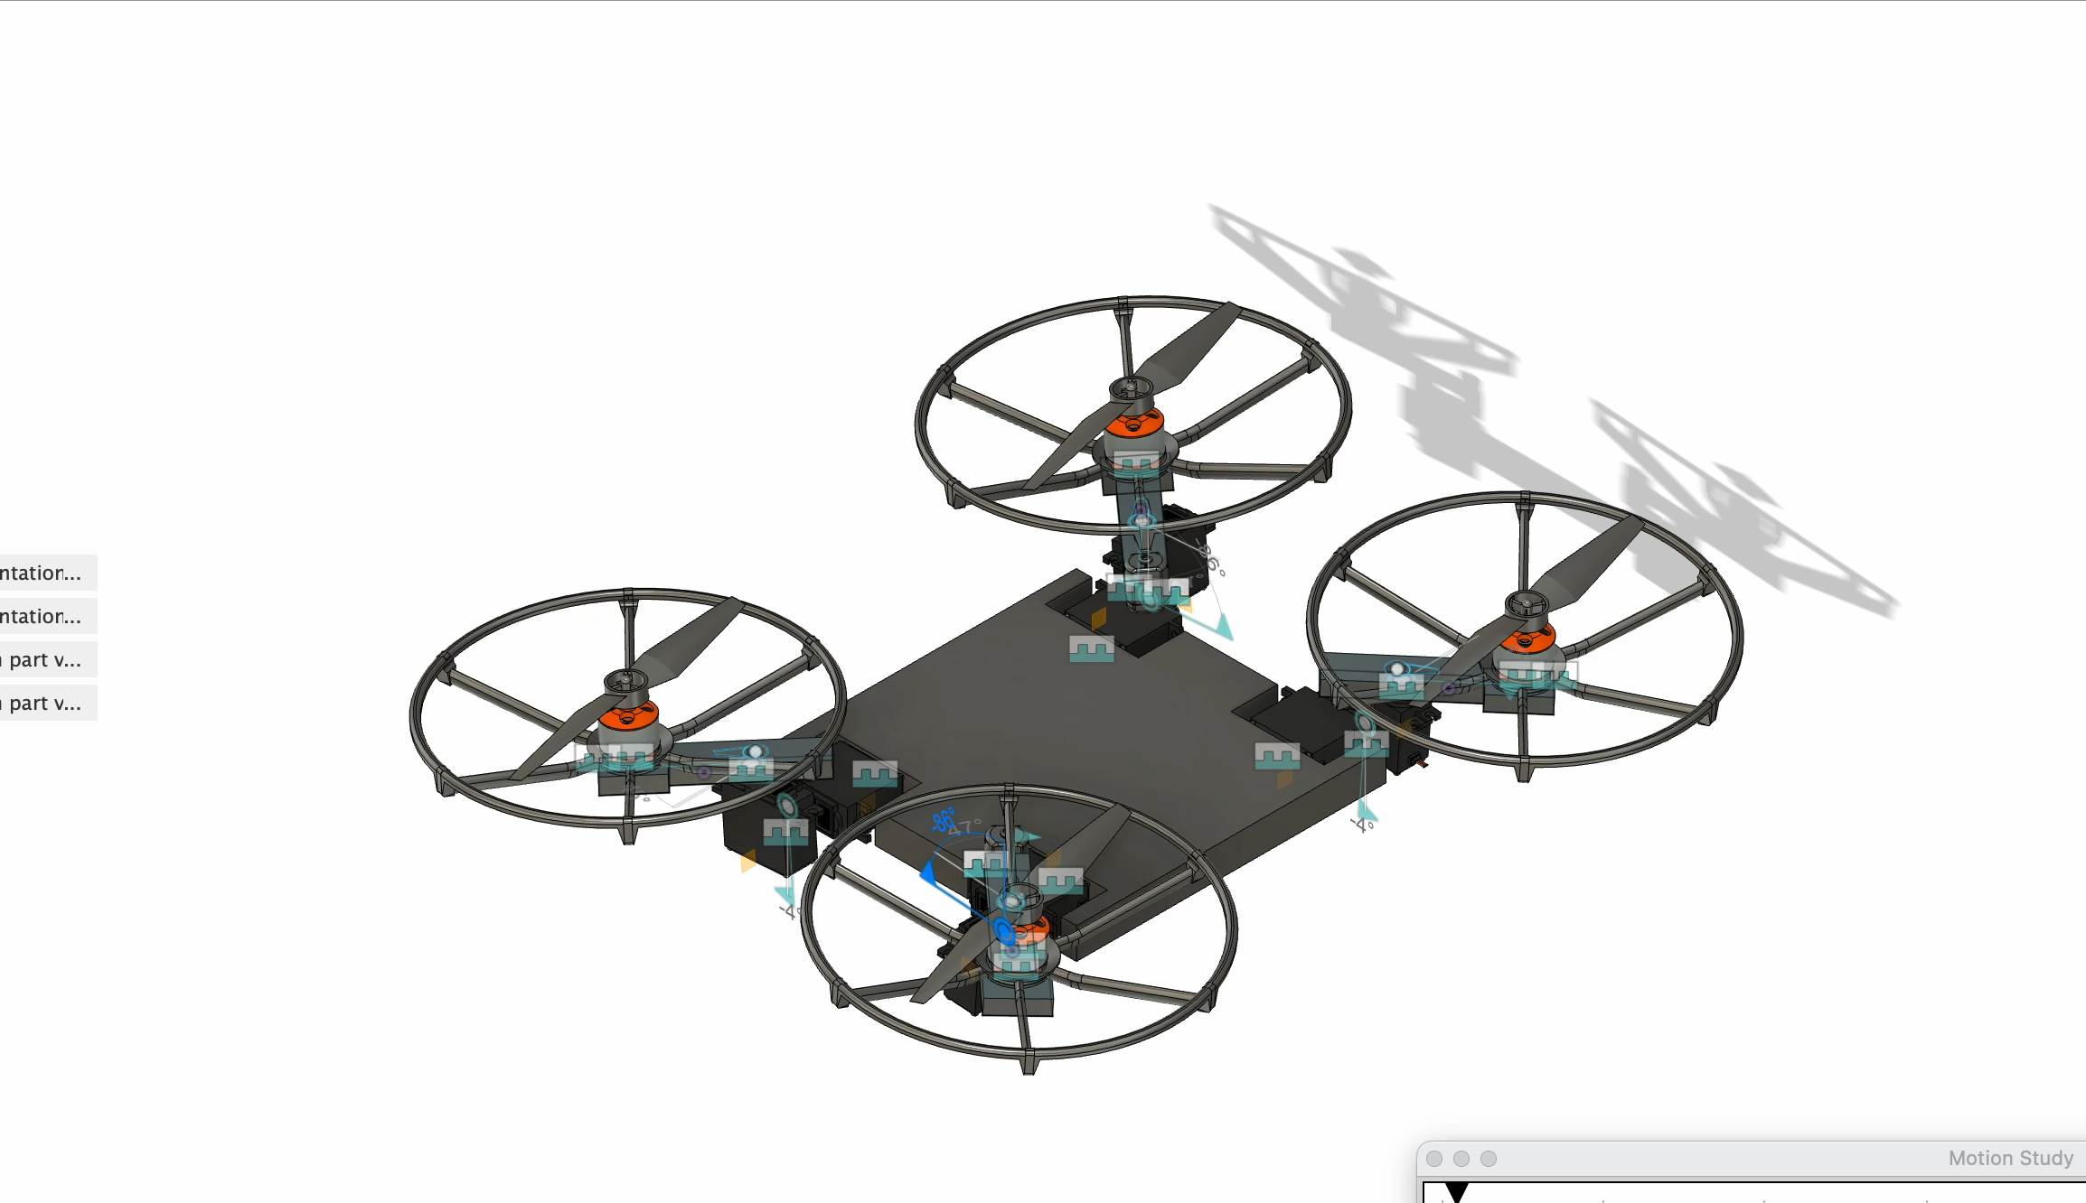
Our IDEA
Our Project Vampire integrates advanced aerial dynamics with sophisticated terrestrial navigation, utilising a unique orientation mechanism to transition from a car-like structure to a drone. The design addresses complex challenges in part integration, circuit design, and microprocessor coordination, ensuring seamless operation across diverse environments.

Slide 3

Key features
With help of belt drive system this vehicle can be driven on terriastial terrian like a car.
With help of propellers and rotatory arms , this can generate thrust and fly like a drone.
Co-centric axis of rotation of bldc motor and tyre with help of ball bearings
Servos helping to provide 3 degree of freedom to arm in a controlled manner.
Efficient power consumption.
Unique transformational ability distinguishing from other normal vehicles.
High milage even in uneven terrians like mountains and Valles even without proper infrastructure.
Lightweight and Durable Construction- Built with high-strength, lightweight materials to maximize performance and durability in both flight and ground operations.

Slide 4
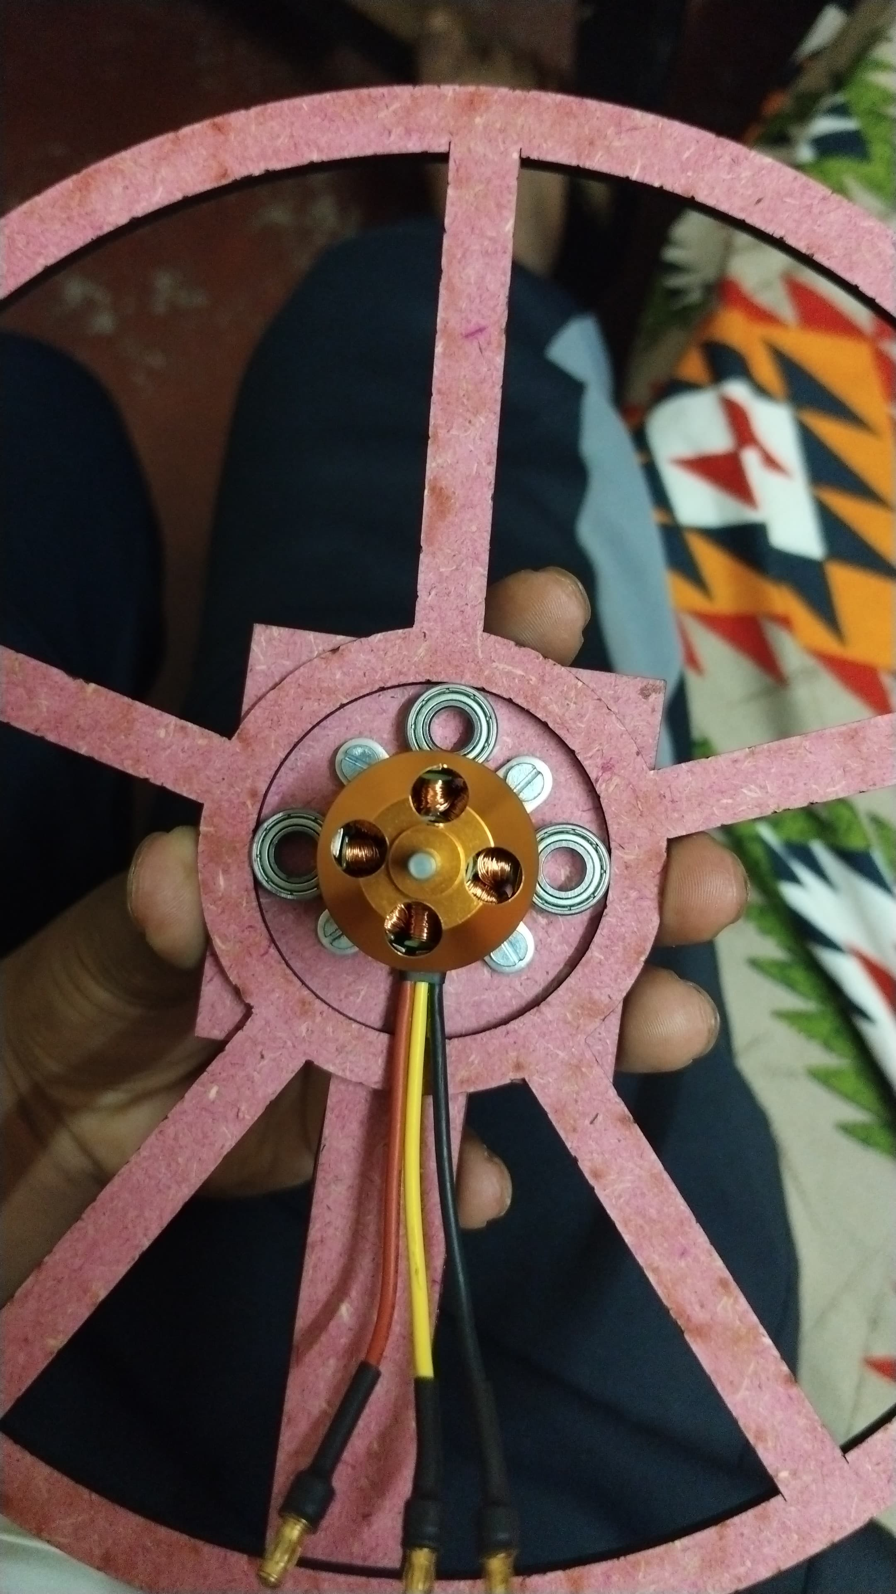
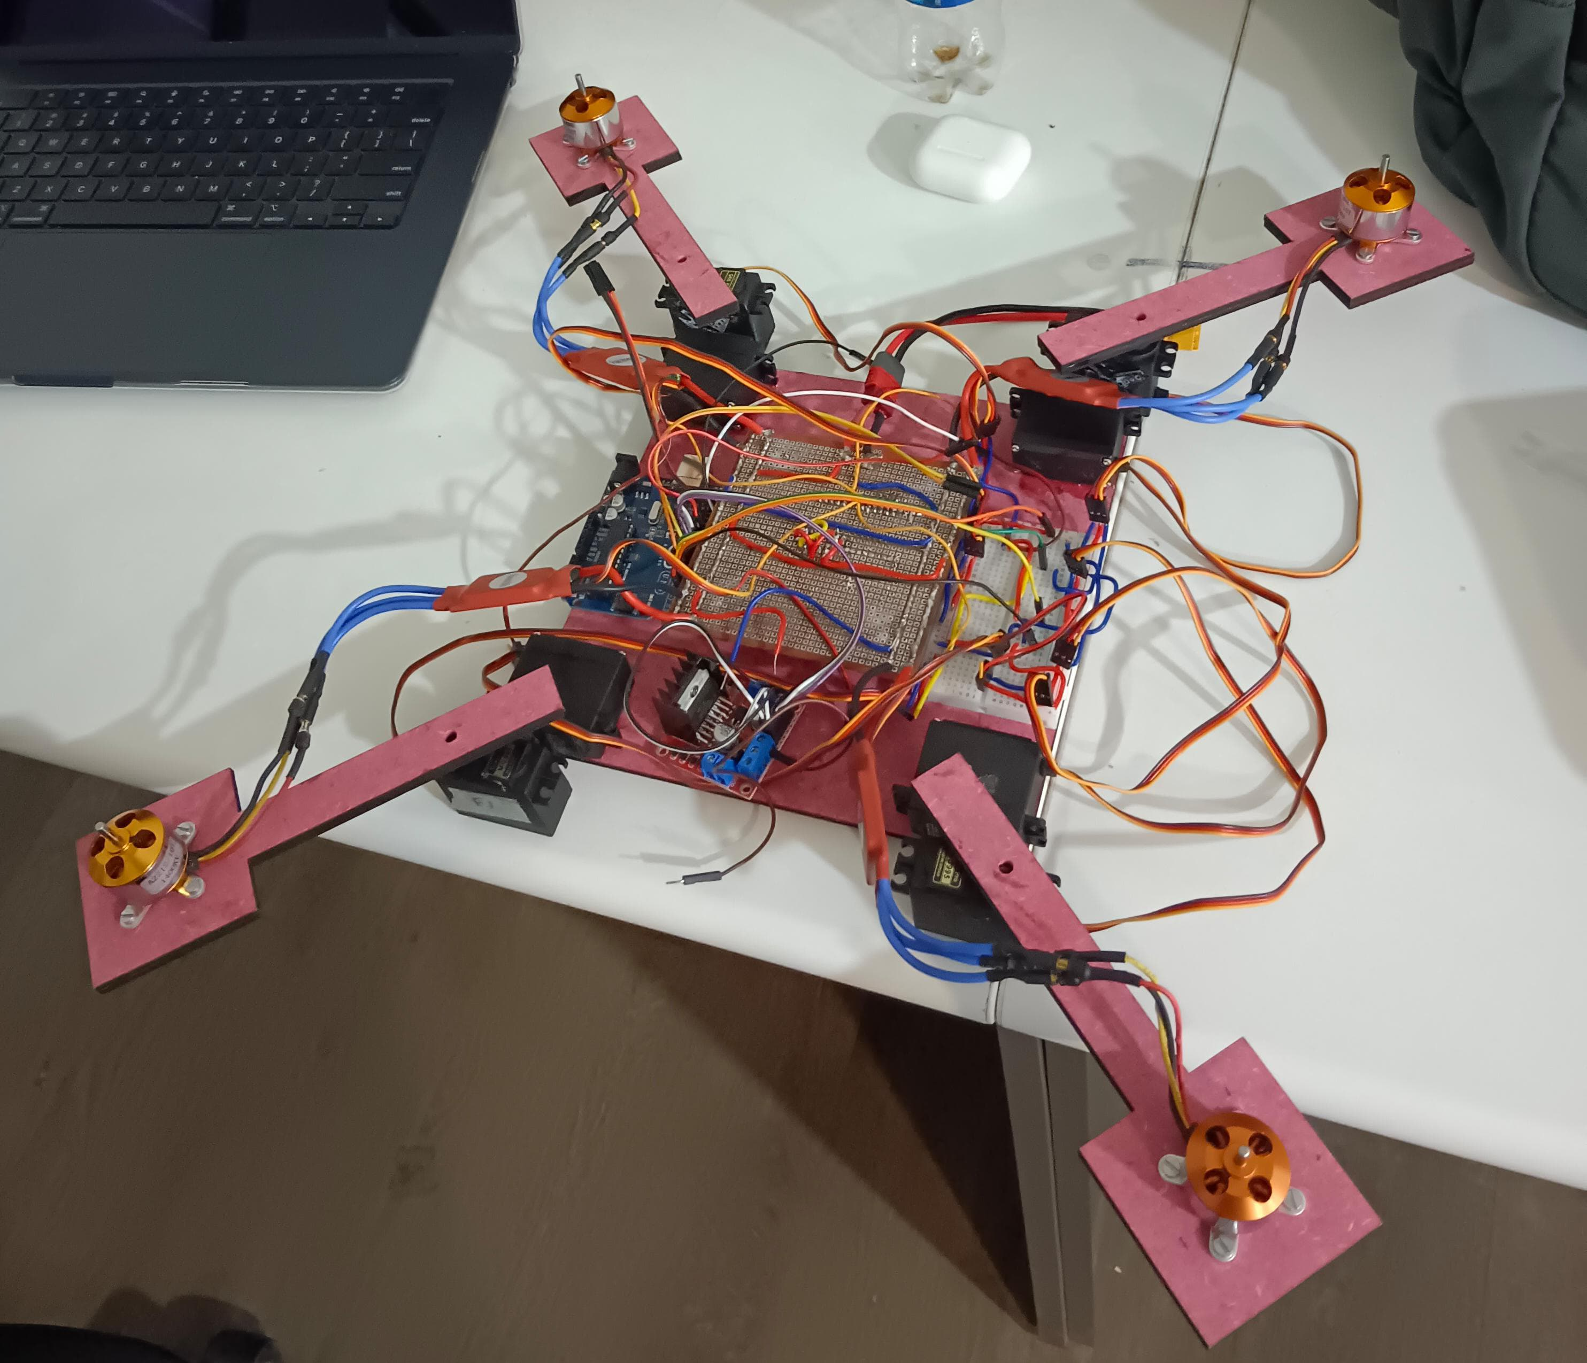

Slide 5
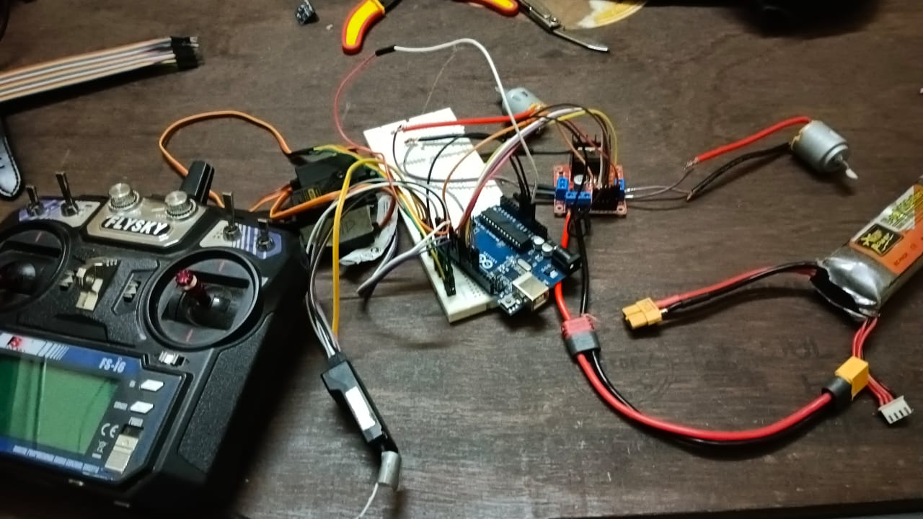
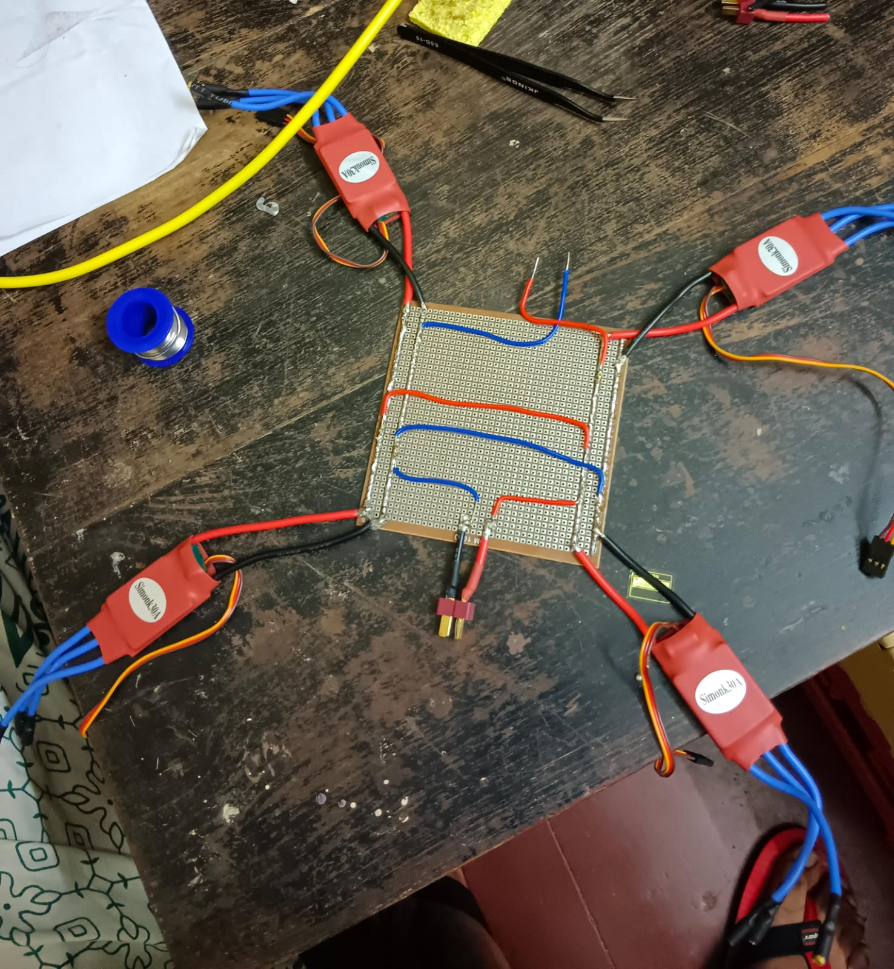

Slide 6
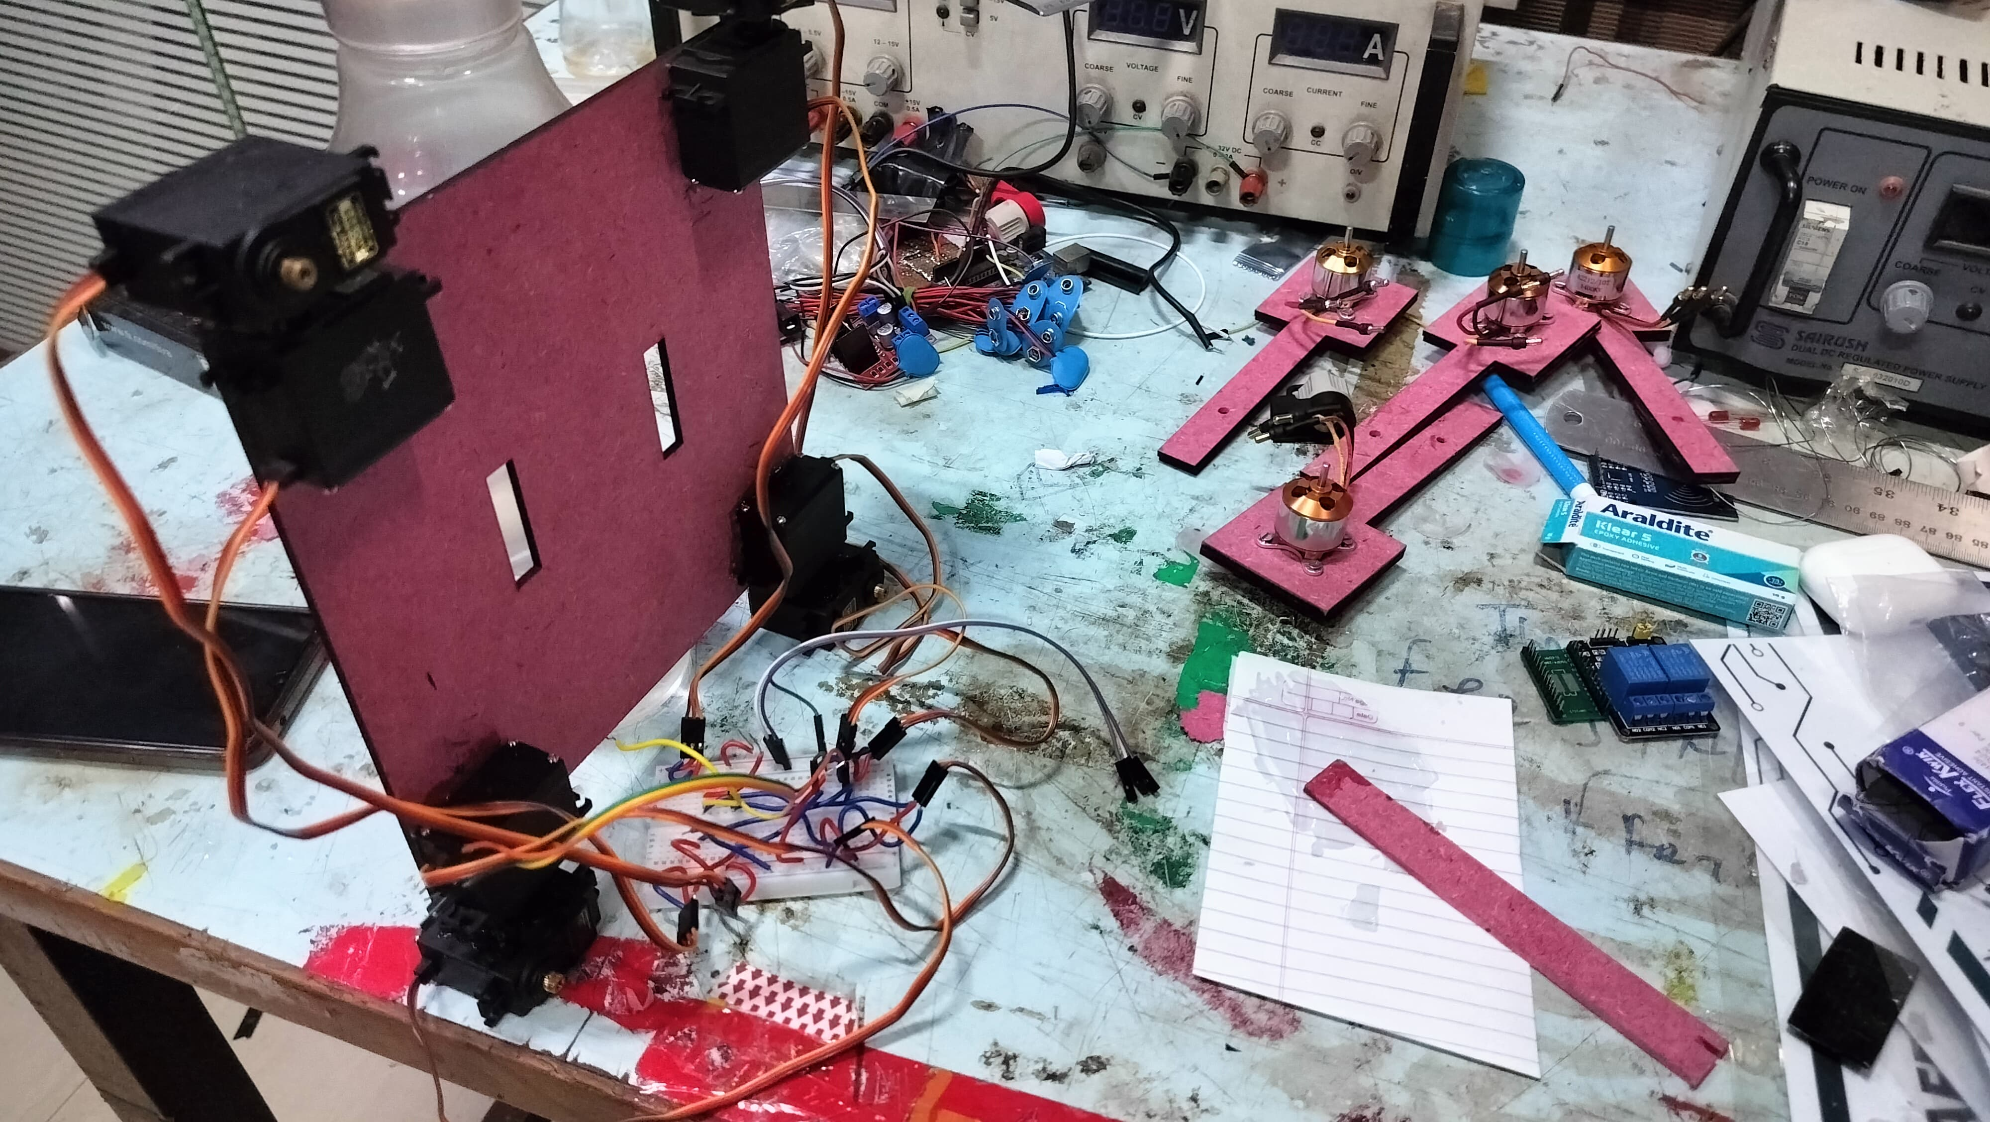
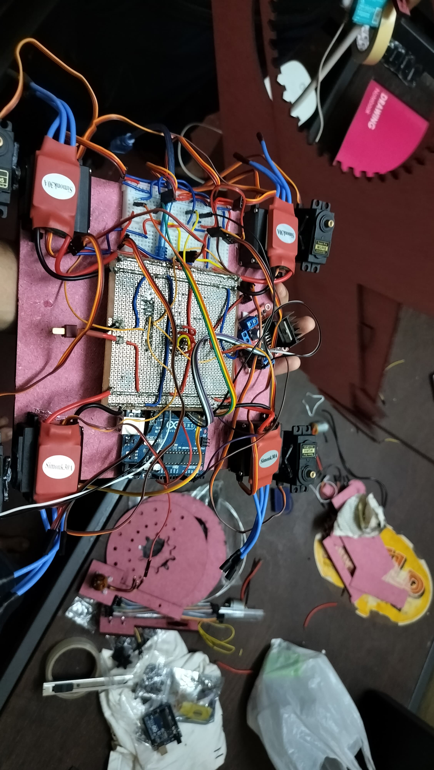
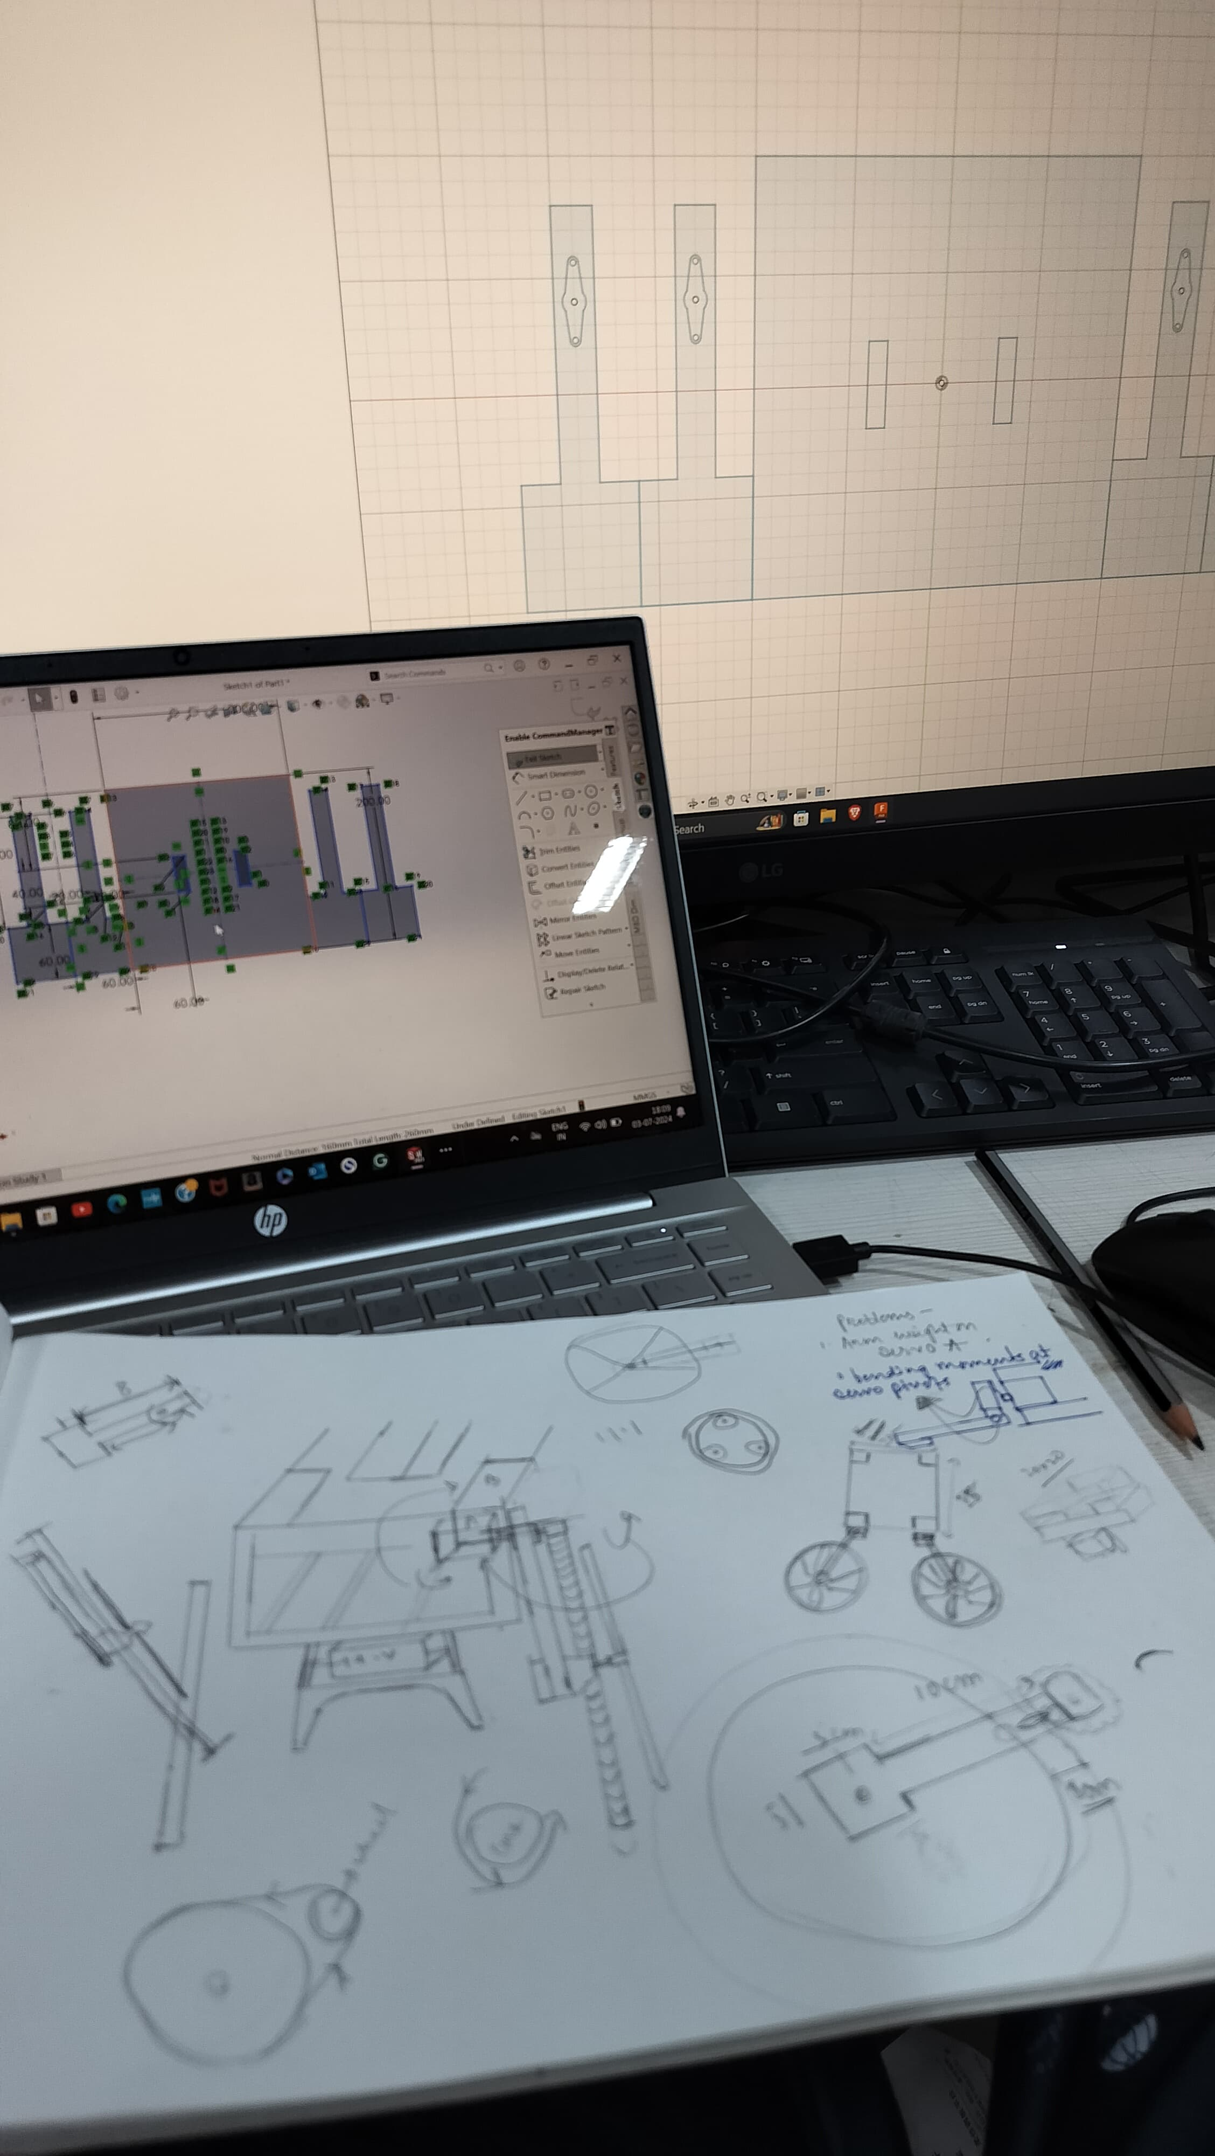
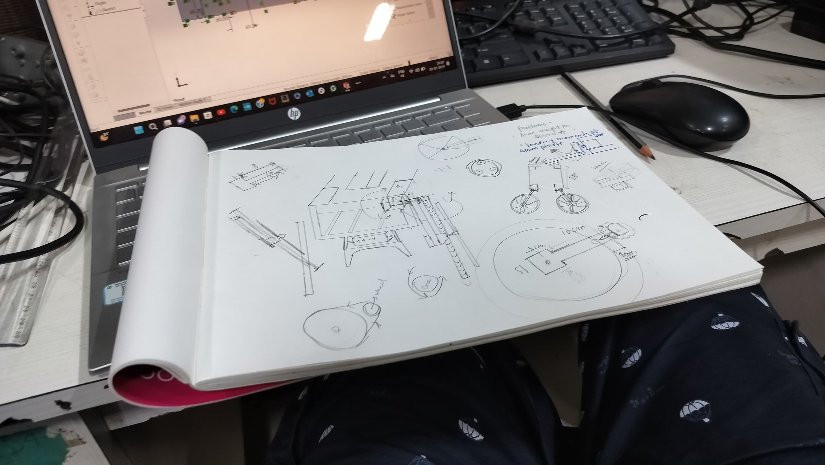

Slide 7
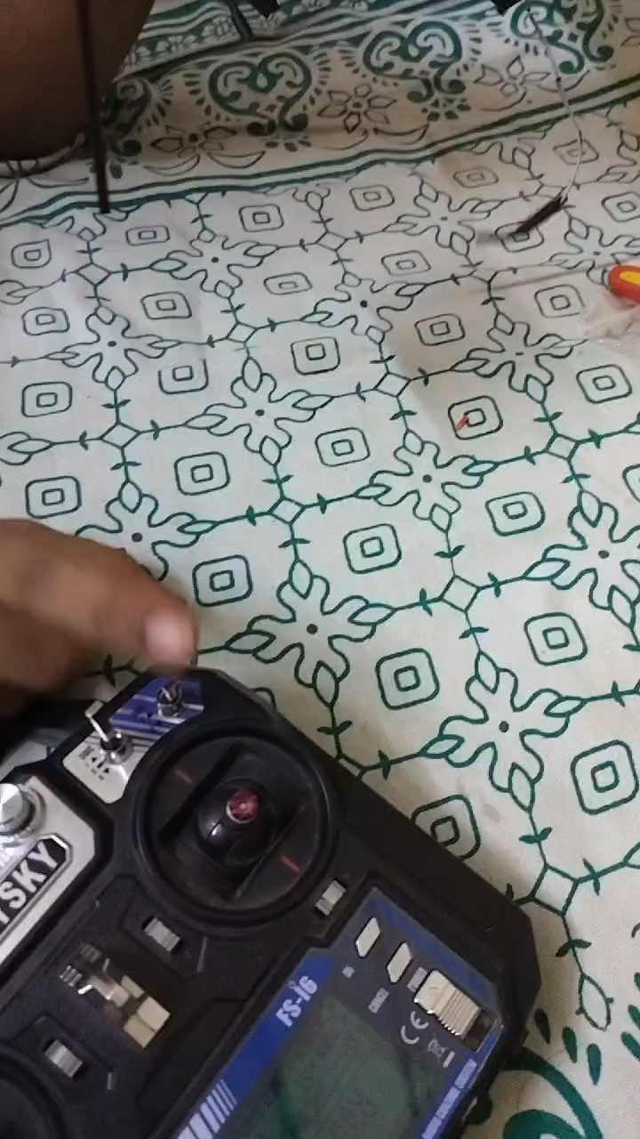
You can see here our model (without motors attached) is working absolutely fine , the model here was worked till completion of all electrical circuit and distribution the outputs of ESCs and motor driver have be checked with multimeter which confirms the proper passing of current according to our idea of controlling the vehicle.

Slide 8
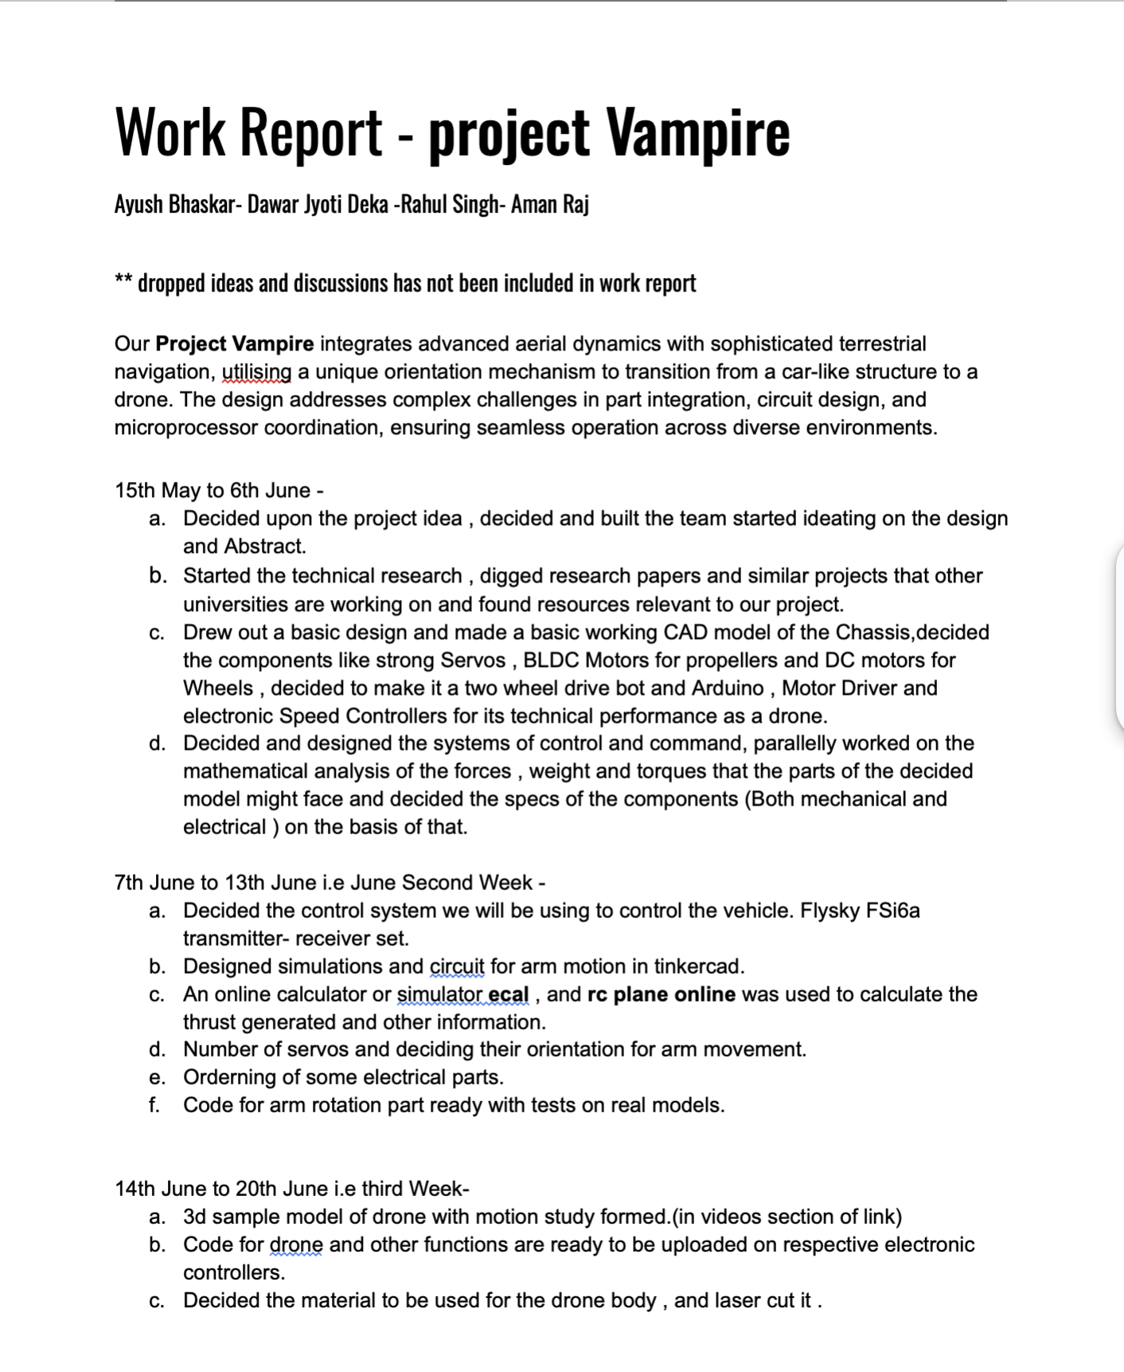
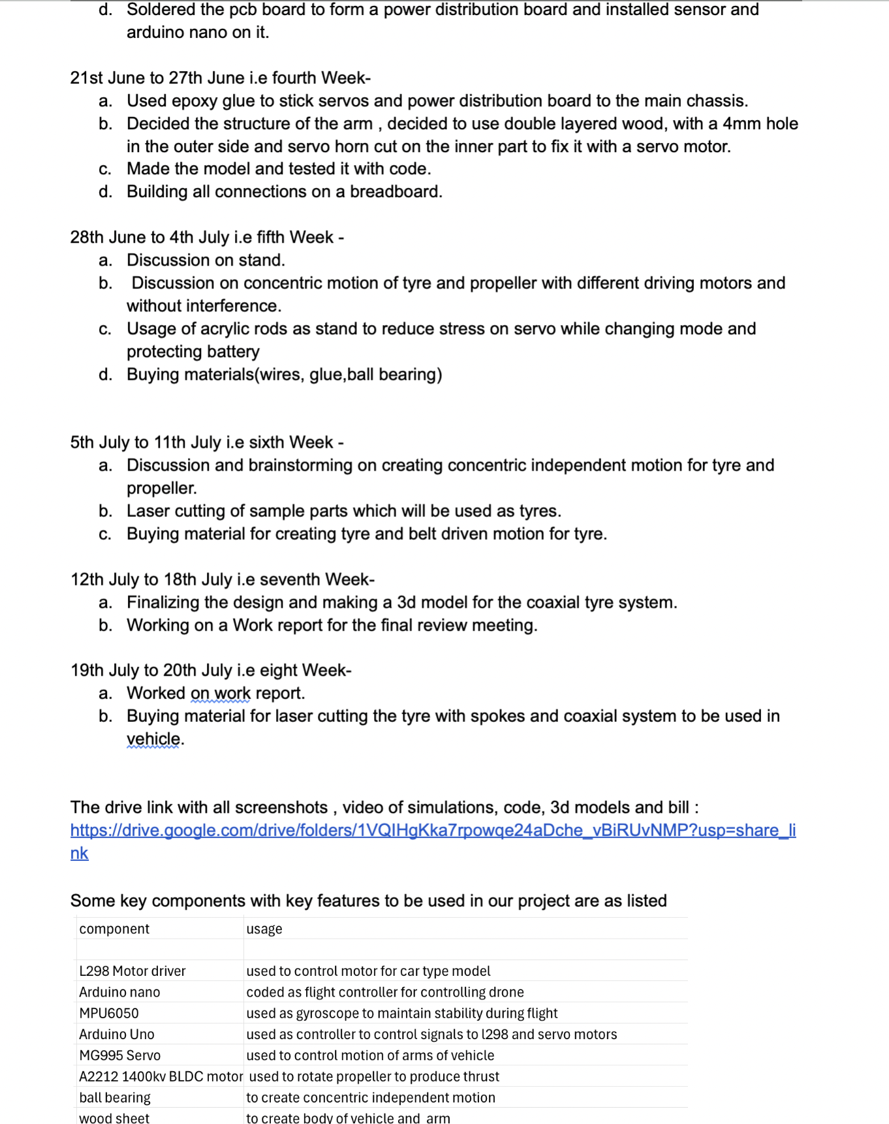

Slide 9
BT Faced
Controlled signal distribution to car driver and drone driving microcontrollers from receiver.
Servo mg995 not working properly when power supplied from Arduino uno.
Creating co-centric axis independent motions with different driving force.
Extra weight of 3d printed stand(as per simulation).
Placement of ball bearing on arm.
Spokes creation and placement. (Initially metal spokes were decided)

Slide 10

How we deal them??
Using pin 12 of Arduino uno as power supply of Arduino nano.(tentative)
Changing power supply to ESC to reach required current for servo movement.
Analysing the principle of working of one ball bearing and implying it to it’s set.
Decided to use acrylic rods as an stand and battery strap to hold battery.
Decided to use geometry to figure out bet possible points.
Decided to use same material as tyre as spoke and analyse , and if required to add metal spokes further to add strength.

Slide 11

Practical applications
Improved Accessibility: Hybrid vehicles can provide better access to remote or rural areas where traditional infrastructure is lacking or underdeveloped.
Emergency Response: They can quickly reach areas that are otherwise hard to access by road, providing crucial support in emergencies.
Traffic Reduction: Flying cars can alleviate ground traffic congestion by providing an alternative transportation layer above existing road networks.
Reduced Commute Times: They can significantly shorten travel times, especially in densely populated urban areas with heavy traffic.
Disaster Response: They can be used to reach disaster zones quickly, providing medical supplies and evacuation services.
Versatile Deployment: These vehicles can be deployed in various terrains, including mountains, forests, and urban environments, for search and rescue operations.
Aerial Surveillance: They can provide an aerial view of disaster areas, helping in the coordination of rescue efforts.
Efficient Logistics: Flying cars can streamline the delivery process, reducing the time and cost associated with last-mile delivery.
Remote Destinations: They can provide access to remote and scenic destinations that are difficult to reach by conventional means.
Door-to-Door Service: Hybrid vehicles can provide door-to-door transportation, combining the flexibility of a car with the speed of a drone.

